Slide 1

Emergency Vehicle Awareness
Matthew Ige, Rachel Kinney, Bailey Parker, PJ Piantone, Andrew Zhu
Notes:
Bailey

Slide 2
Emergency Vehicle Early Warning System
Background
Our Approach
Our Models
Client/Server - Cellular
Peer to Peer - RF
Benchmarks
Conclusion & Future Works
Demo

Slide 3

Nearly 300,000 people die each year to cardiac arrest
Notes:
Bailey

Slide 4

Nearly 300,000 people die each year to cardiac arrest
30% could be saved by faster response times

Slide 5
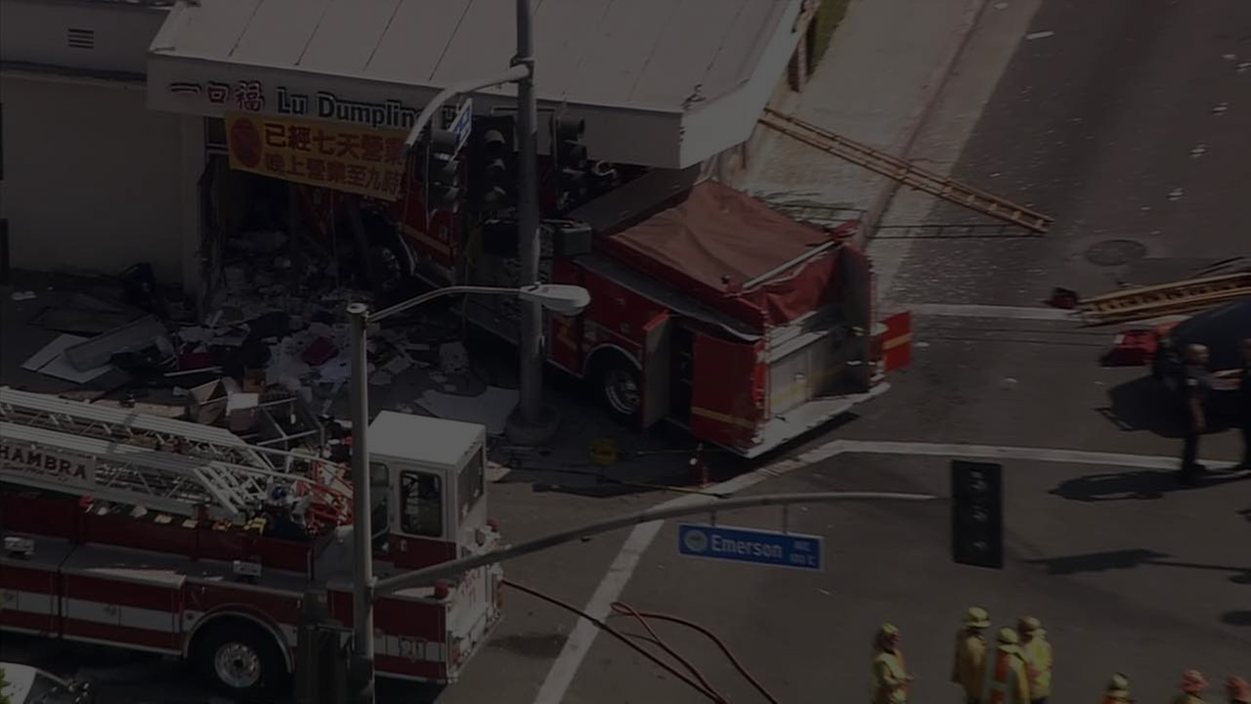
30,000 serious accidents involving fire trucks each year
Notes:
Bailey

Slide 6

Notes:
Bailey

Slide 7
Background
There are too many accidents that happen each year involving emergency vehicles
Our current alert system (lights and sirens) has seen few advances in the past decades
With modern wireless technology we should be able to alert drivers before they can even hear or see emergency vehicles
Notes:
Bailey

Slide 8
Emergency Vehicle Early Warning System
Background
Our Approach
Our Models
Client/Server - Cellular
Peer to Peer - RF
Benchmarks
Conclusion & Future Works
Demo

Slide 9
Our Approach
Emergency Vehicles broadcast their location, and receiving vehicles can react appropriately
How to accomplish this?
Client / Server - Cellular
Peer to Peer - RF
Notes:
Rachel

Slide 10
Early Testing - Client / Server (Cellular)
Early Testing - Peer to Peer (RF)
What does mobile data performance look like?
How does it compare to WiFi?
Test Application
Lead us to three possible models
Hardware experimentation
Notes:
Rachel

Slide 11
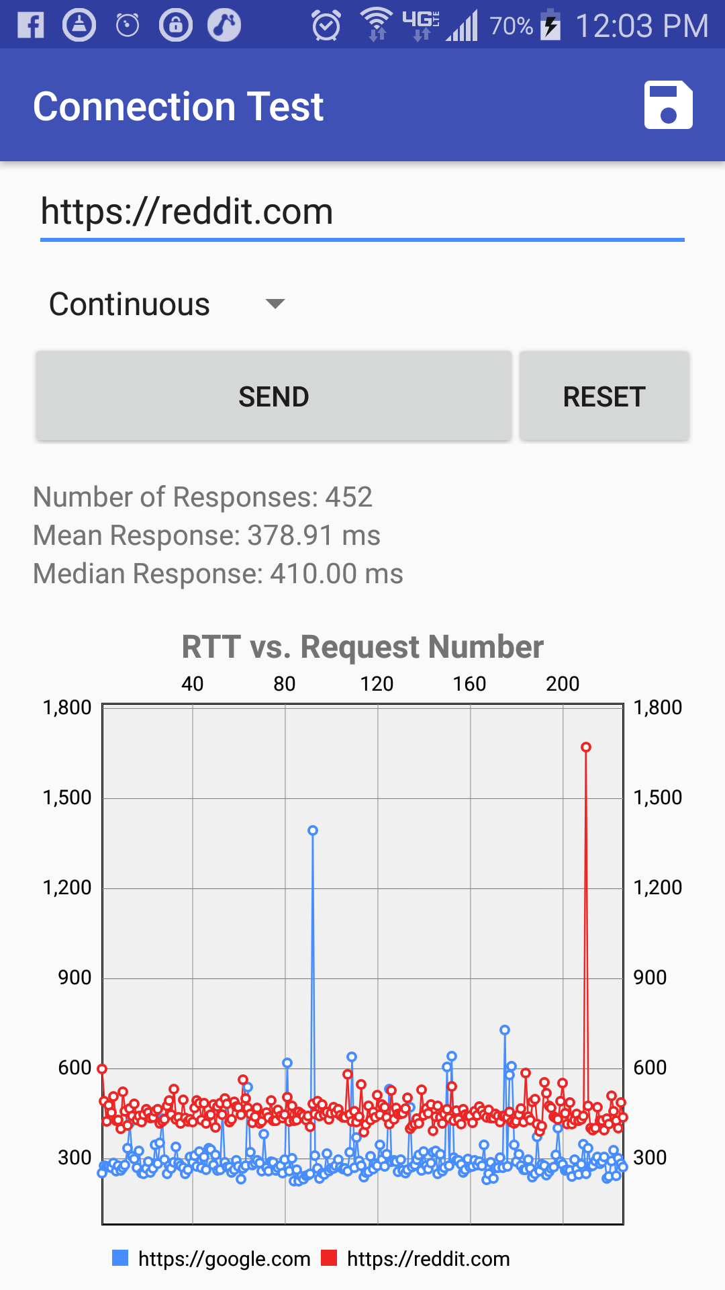
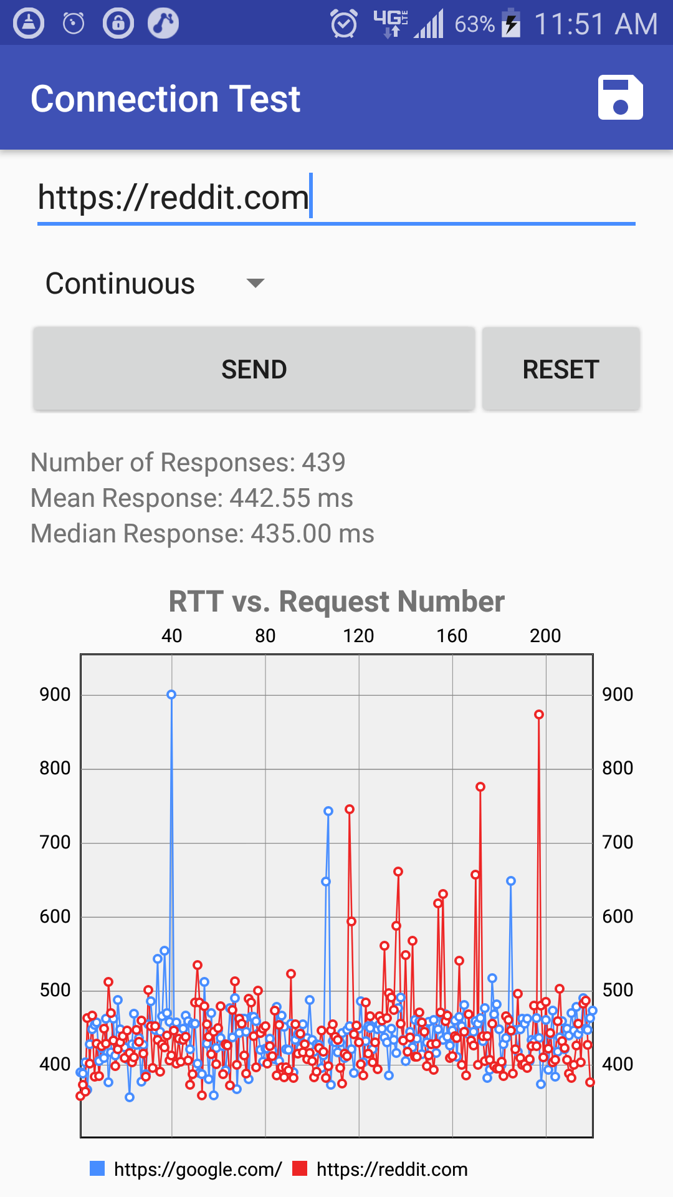
Connection Test Application
RTT vs Request Number
1,800
WiFi
hopkins network in Malone
Mean: 300 - 450 ms
Median: 410 ms
More consistent, but more dependant on specific URL
Mobile Data
4G from Malone
Mean: 442 ms
Median: 435 ms
More variability
1,500
1,200
RTT (ms)
900
600
300
0
Request Number
Request Number
Notes:
Rachel

Slide 12
Emergency Vehicle Early Warning System
Background
Our Approach
Our Models
Client/Server - Cellular
Peer to Peer - RF
Server Benchmarks???
Conclusion
Demo

Slide 13

Peer to Peer (RF) Method
Prototyped with an Arduino
P2P between cars
Uses smartphone for GPS and mapping of emergency vehicles
Notes:
PJ

Slide 14
Peer to Peer (RF) Overview
Decentralize our alert system for faster warning propagation
Similar to 802.11p, which was designed for inter-car communications
P2P, with alerts originating from equipped emergency vehicles
The emergency vehicle constantly broadcasts to surroundings
Easily scalable
Very fast communication (~10ms per hop)
All devices forward any alerts they receive, propagating messages away from their sources
Notes:
PJ

Slide 15

Client/Server (Cellular) Method
Deployed as a smartphone app
Client/Server Model
TCP-based protocol over 4G/LTE
Central Server Alerts Drivers

Slide 16
Client/Server (Cellular) overview
Maintain a centralized list of users and their current locations
Server client model
Emergency vehicles send their messages to the server which then alerts all users near the vehicle
Takes advantage of existing infrastructure
Rely heavily on 4G/LTE coverage and future innovations to wireless infrastructure to handle communications
Use Firebase to message all clients instead of server
Potential to give warnings even earlier than RF
Notes:
PJ

Slide 17
Emergency Vehicle Early Warning System
Background
Our Approach
Our Models
Client/Server
RF
Benchmarks
Conclusion & Future Works
Demo

Slide 18
Discarded Strategy: Firebase-Only Approach
Firebase can have users join “groups”
We would associate a “group” with a geographical bucket
All clients join and leave groups as their location changes
Emergency vehicles send notifications to the nearby groups
Jeff Dalla Tezza cautioned against this:
Firebase is not designed to handle the churn of our users switching groups rapidly
Recommends we store Firebase ID’s and directly message devices
Emergency
Vehicle
Firebase
C
C
C
G
G
G
G
G
G
G
G
G
Notes:
Matt

Slide 19
Method: Hybrid Server/Firebase
Clients receive a unique token from Google
Clients pass our server the token
Clients periodically update our server with location
On emergency, we send appropriate tokens to Google, who then manages the notifications to clients
Emergency
Vehicle
Our Server
Firebase
C
Notes:
Matt

Slide 20
Method: Hybrid Server/Firebase
Pros:
Load on our servers is lower
Utilize Google’s resources
Cons:
Need to store location of all users
Additional latency from using Firebase
Emergency
Vehicle
Our Server
Firebase
C
Notes:
Matt

Slide 21
Method: Server-Only Approach
Emergency vehicles constantly send the server their location
Server only stores the locations of emergency vehicles
Clients send periodically their location, and ask, “is there an emergency in my area?”
Clients can additionally sent older locations for better heuristics on the server
Emergency
Vehicle
Our Server
C
C
C
Notes:
Matt

Slide 22
Method: Server-Only Approach
Pros
Lowest expected latency from server/client approaches
We already round trip connections to the client for each update, so we might as well take advantage of that response
Less information to store server side (more scalable!)
Emergency
Vehicle
Our Server
C
C
C
Notes:
Matt

Slide 23
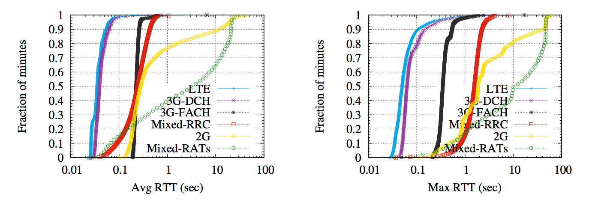
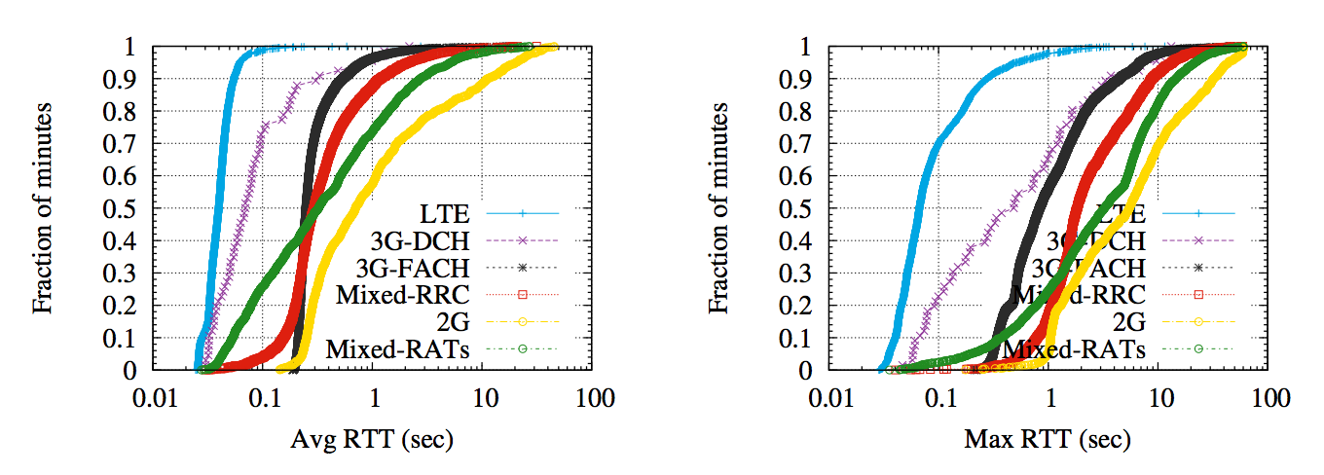
Stationary Mobile Packet Loss
Mobile Packet Loss in a Vehicle
Notes:
Matt

Slide 24
Method: Server-Only Approach (Faster?)
Scaling to millions of cars making millions of TCP connections is impractical
Car interaction with the server is stateless, side-effect free, and brief
Replace HTTP with space efficient binary system
Emergency vehicles still communicate over TCP
Cars can use a simple UDP with retry protocol to avoid the 3-way handshake
Emergency
Vehicle
Our Server
C
C
C
Notes:
Matt

Slide 25
Emergency Vehicle Early Warning System
Background
Our Approach
Our Models
Client/Server - Cellular
Peer to Peer - RF
Benchmarks
Conclusion & Future Works
Demo

Slide 26
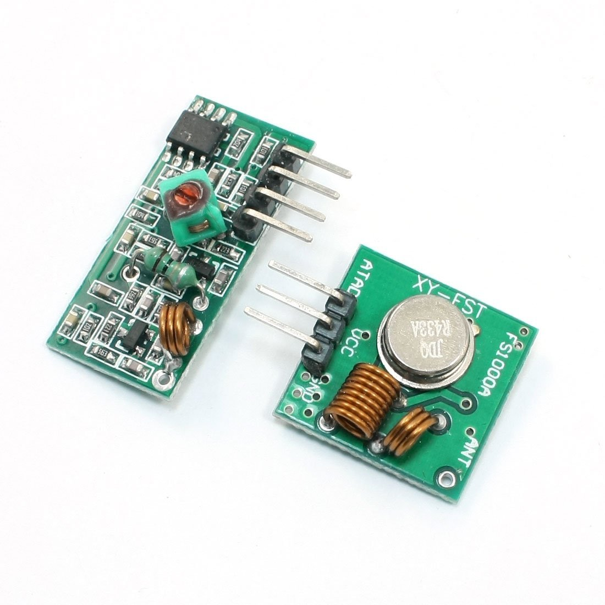
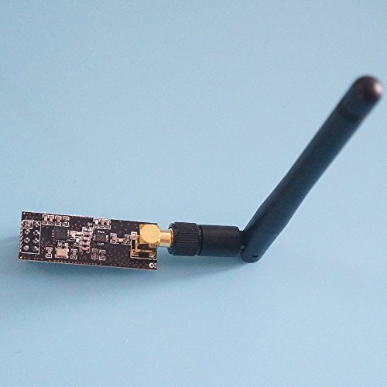
Peer to Peer (RF) approaches
Tested with both 433MHz and nRF24l01 (2.5GHz) transmitters
Found better range and library support for nRF24l01
Notes:
https://www.amazon.com/433Mhz-Wireless-Transmitter-Receiver-Module/dp/B00GYV0YNM
https://www.amazon.com/Nrf24l01-Antenna-Wireless-Transceiver-Communication/dp/B00OIQ8FS6

Slide 27
Peer to Peer (RF) Hardware Details
nRF24l01 with line of sight has range of about a football field - 120 yards. Loss of 5-10%
Maximum message length of 32 bytes

Slide 28
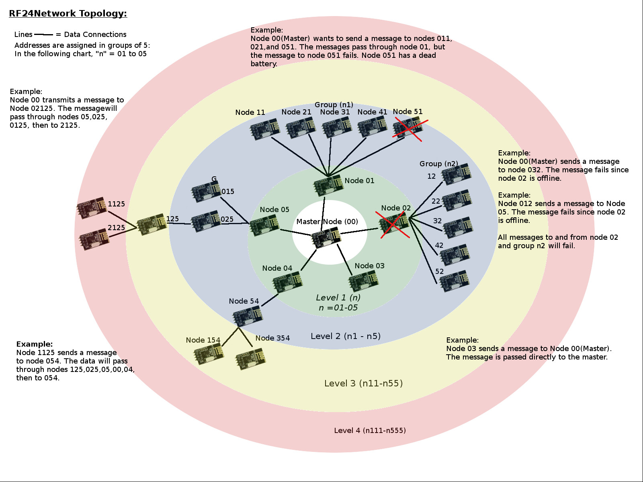
RF24 Details
Used the RF24 library by TMRh20
Library supports reads, writes, multiple channels
Library supports IP-like addressing & mesh network, but overhead was too high for nodes in motion
Notes:
Andrew
Image from https://tmrh20.github.io/RF24Network/Tuning.html

Slide 29
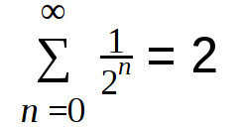
Peer to Peer (RF) Protocol
Emergency vehicles create alerts, send them out via broadcast
Each created message has an ID and a TTL
Messages that are received by civilian vehicles are retransmitted with probability 1/(2^n). n = times message has been retransmitted
In a busy environment, civilian vehicles are expected to retransmit each message 2 times:
Notes:
Andrew

Slide 30
Peer to Peer (RF) Protocol
If the network is busy, transmitters will wait a random amount of time (up to 10ms) before attempting to transmit again.
Based on Carrier-sense multiple access (CSMA) protocols.
Older versions displayed message paths, knowledge matrices
Notes:
Andrew

Slide 31
Emergency Vehicle Early Warning System
Background
Our Approach
Our Models
Client/Server - Cellular
Peer to Peer - RF
Benchmarks
Conclusion & Future Works
Demo

Slide 32
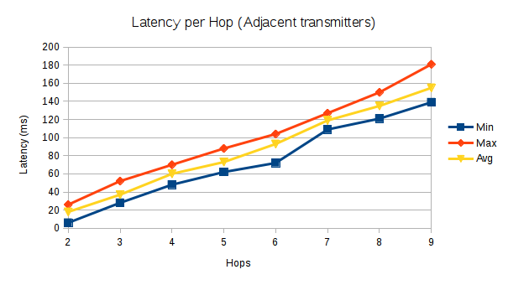
Peer to Peer (RF) Benchmarks
On average, about 18ms per hop
First few hops are faster (~10ms) due to lower message traffic
With android app, much slower due to Serial communication (baud rate = 9600)
Notes:
Andrew

Slide 33
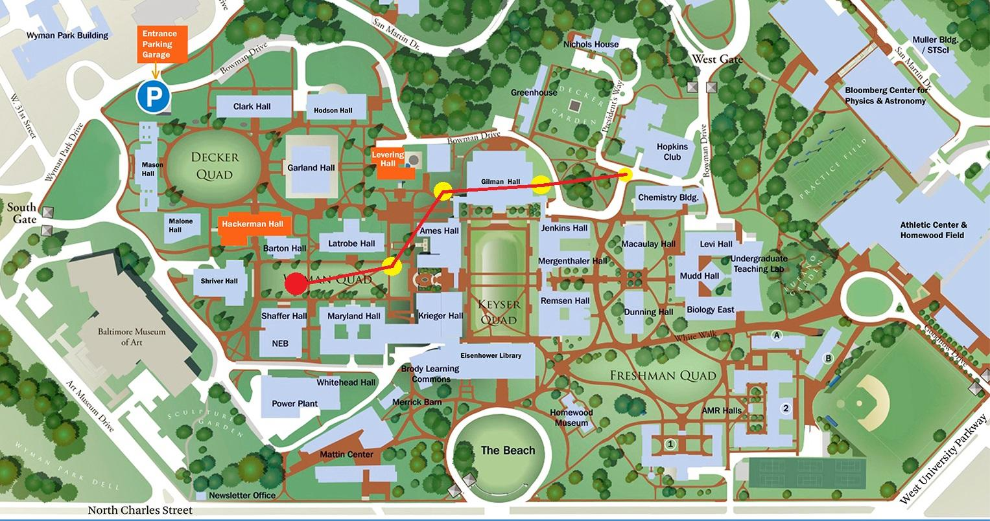
Notes:
https://lcsr.jhu.edu/events/jhu-robotics-industry-day-2017/#.WQtOsOXyu00

Slide 34
Client/Server (Cellular) Implementation Details
Server running in the basement of Malone right now
4 core Intel Xeon 3.20GHz, 3 gigabytes of RAM
Android App (Java)
Python Flask Server (behind uwsgi)/Golang Server
Redis backend (Manage location data)
Nginx reverse proxy

Slide 35
Emergency Vehicle Early Warning System
Background
Our Approach
Our Models
Client/Server - Cellular
Peer to Peer - RF
Benchmarks
Conclusion & Future Works
Demo

Slide 36
Conclusions
We have a version of our system that works for both sides
The RF side may need more tuning in the future to work in crowded situations
The server the app communicates to may eventually need to become distributed to handle increased loads or failures
Adoption of system is likely to be a large hurdle to overcome
Notes:
Rachel

Slide 37
Future Works
Test in actual cars
Smarter decisions using location on the server side
Larger scale RF tests - play with dynamic wait periods, dynamic propagation probabilities, find/develop ways to send longer messages.
Optimize communication between Android/Arduino, do more computation on Arduino to limit Serial communication
Notes:
Rachel

Slide 38
Emergency Vehicle Early Warning System
Background
Our Approach
Our Models
Client/Server - Cellular
Peer to Peer - RF
Benchmarks
Conclusion & Future works
Demo

Slide 39
Demo

